Slide 1
Default of Credit Card Clients
Onkar Deshpande, Magdalene Fogarasi
Jingwei Li, Huixuan Zhu, Yuyan Xu
Ming Zhang, Han Zhou, Tingting Xuan

Slide 2

Background
Data represents demographics, credit card spending, and default rate of customers in Taiwan
Bill amount and payment amount every month: April - September of 2005
Credit limit and default rate at the end of the study
Demographics collected include:
Age, education, gender, and marital status
Data collected from: UCI Machine Learning Repository

Slide 3
Impact and Importance
Credit card companies are interested in how to best choose credible customers
Interesting to companies to see when spending is higher
Promotions
Default rate prediction/probability
How to screen individuals who will not pay back their bills

Slide 4
Hypotheses Outline
Equal Means of Bill Amount
Customers spending is the same (independent from the month)
Spending Trend of customers with respect to month
Default Rate Prediction
Model using demographics information to predict individuals who are more likely to default on payments
Credit Limit Determination
Predicting the credit limit by multi-linear model

Slide 5
Hypothesis 1: Equal Means?
Hypothesis: The mean bill amounts for each month is the same throughout the payment period
H₀: μ_{May}= μ_{June}=...= μ_{September} ; H_{a}:At least one ≠
Multiple equality demands for ANOVA method. Assumption for which is that the columns have equal variance.
To check equal variance, F-test was conducted between all pair of columns
Result of F-test was also checked visually
Hence, used Bonferroni test at significance level 0.1 to check equal means over consecutive months to identify trend in the data.

Slide 6
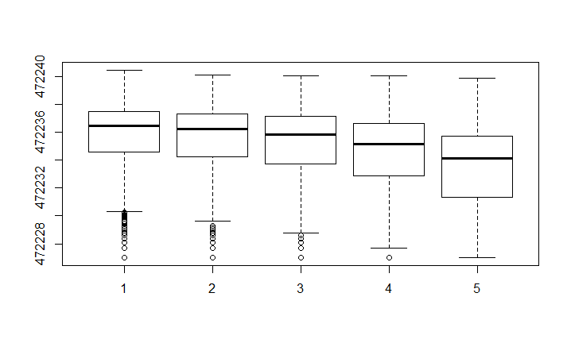
Variance test
Comparison | P Value
May- June | 2.2e-16
June-July | 2.2e-16
July-August | 2.2e-16
August- September | 2.2e-16
May-July | 2.2e-16
May-August | 2.2e-16
May-September | 2.2e-16
June-August | 2.2e-16
June-September | 2.2e-16
July-September | 2.2e-16
Variance in Bill Amount per month is not equal

Slide 7
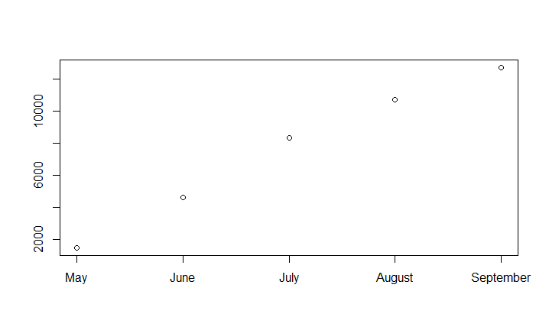
Bonferroni Test @ significance 0.10
Comparison | P-Value
May-June | < 2.2e-16
June-July | <2.2e-16
July-August | 2.543e-12
August- September | 2.085e-09
Overall Trend:
The mean amount spent is increasing from May to September when benchmarked against the initial April Bill Amount

Slide 8
Hypothesis 1: Conclusion
Bill amounts are not the same throughout months
Consumer spending in different months varies
Further work: Factors that affect spending and validate our findings

Slide 9
Hypothesis 2: Understanding variables contributing to default rate
Data Preprocessing:
Choosing the history of past payment, amount of bill statement and amount of previous payment as our variable candidates, the periods are six month.
Using the summation of the history of past payment in 6 months as one variable. Since there are some negative values, the same positive value is added to the summation in order to adjust the minimum values to positive one. Thus we get a new variable.
Setting the negative values in the bill statements and previous payments as “1” (relatively few negative numbers). After log transformation, they will be 0.
Log transformation for all the chosen variables.

Slide 10
Introduction of Sampling method
The dataset contains defaulters vs non-defaulters in 1:4 ratio, hence we used balanced sampling method to fit a good model.
We divided the samples with payment default into two parts: one is training samples (we will call them “training 1 samples” in the following) and another as testing samples (we will call them “testing 1 samples in the following).
If we want to train n samples totally, we will first choose n/2 samples from the samples with non-defaulters. Then, we will choose the left n/2 samples from the training 1 samples.
If n/2 is large than the total number of the training 1 samples, we will first choose the whole training 1 samples and next resampling from the training 1 samples for the left.
This method can guarantee enough and balanced sample numbers for both groups containing defaulters and non-defaulters.

Slide 11
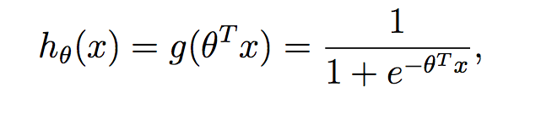
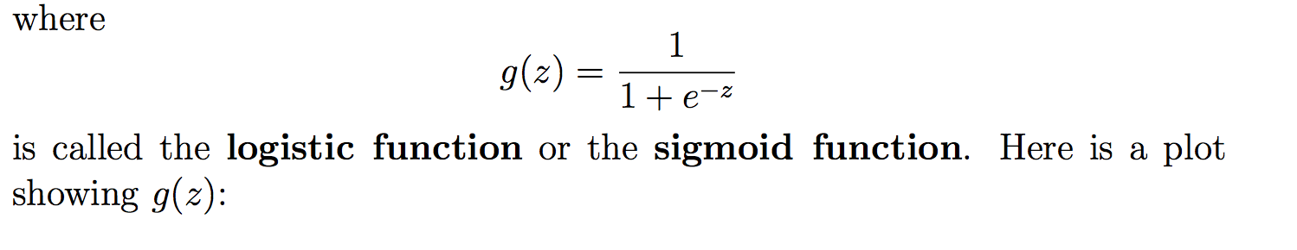
Logistic regression
Here,we want to predict the value of the payment default. It is a classification problem. However, the payment default has a discrete value--0 or 1. The linear regression algorithm will produce poor results. To fix this problem, we will choose the hypothesis as follows:
@cited from Stanford Open Classes, CS229 Lecture notes, Andrew Ng

Slide 12
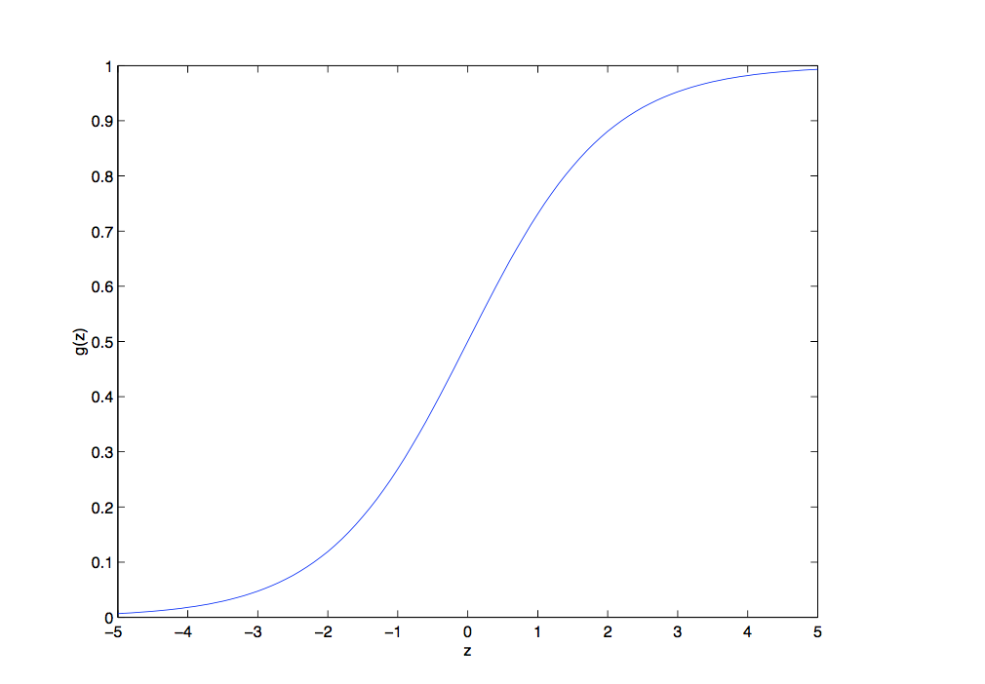
@cited from Stanford Open Classes, CS229 Lecture notes, Andrew Ng

Slide 13
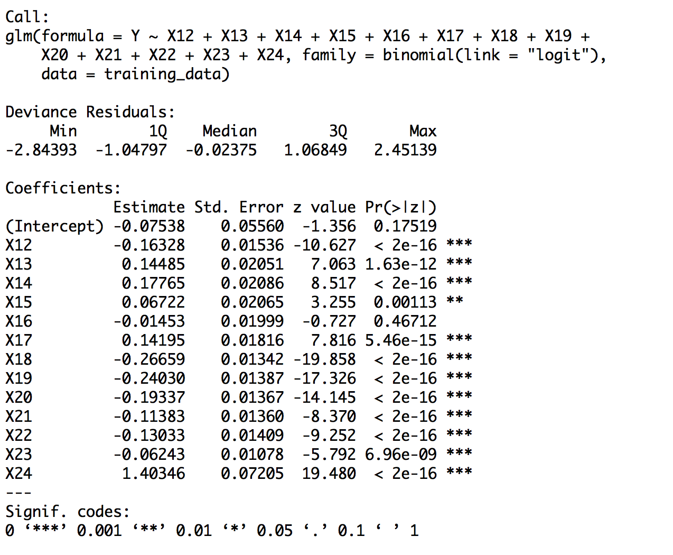
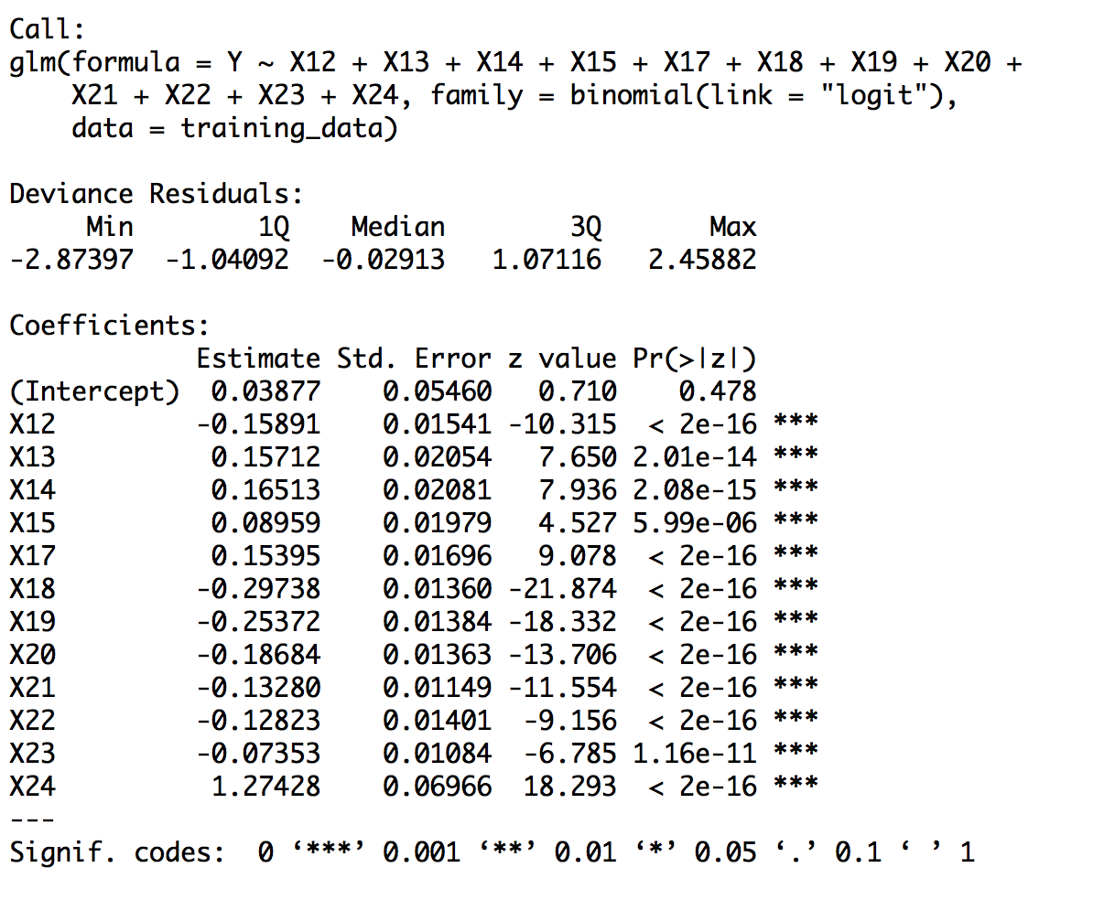
Model Analysis
Insignificant!!!

Slide 14
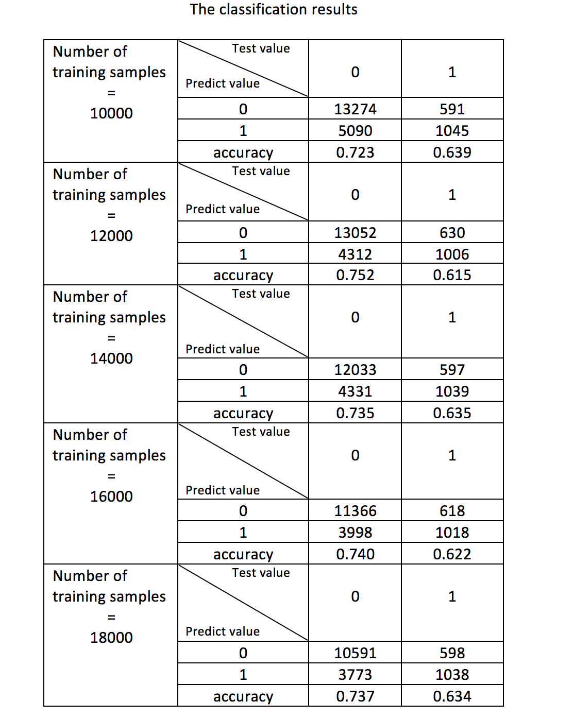
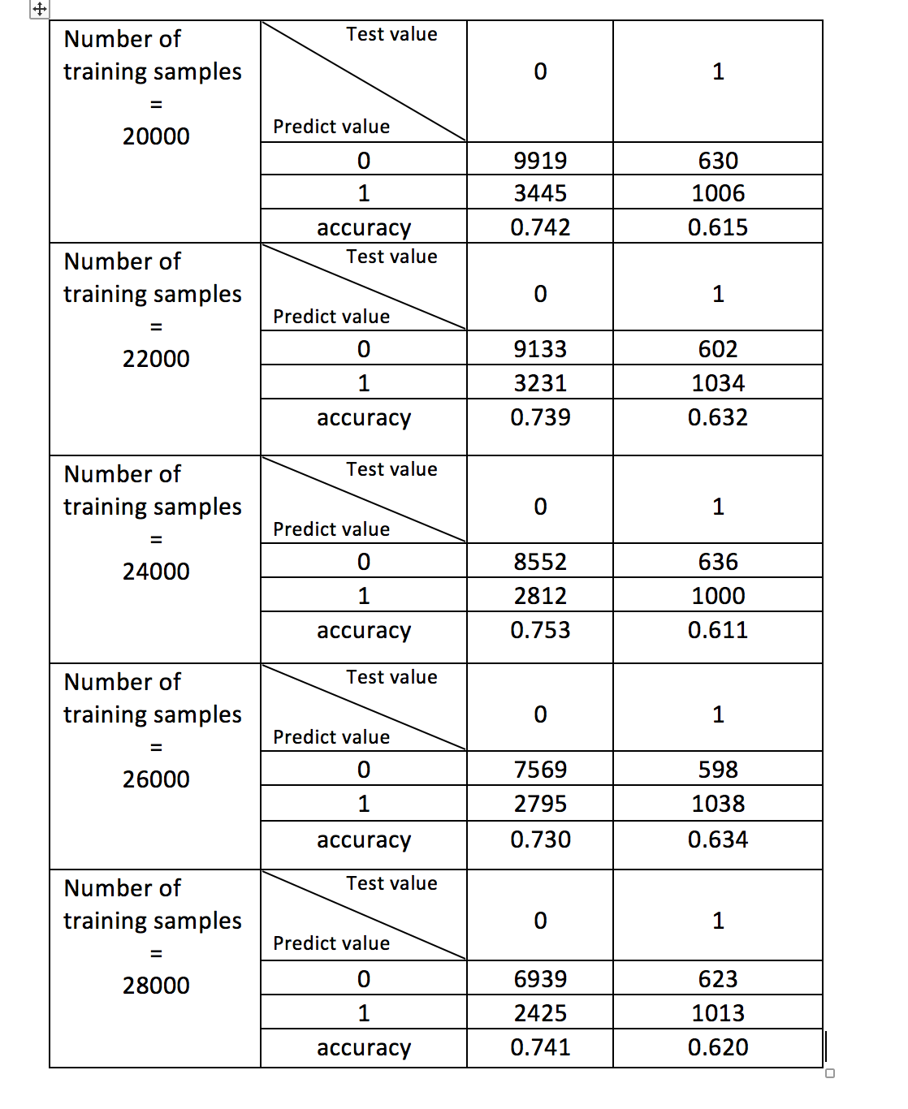
The results of the classification

Slide 15
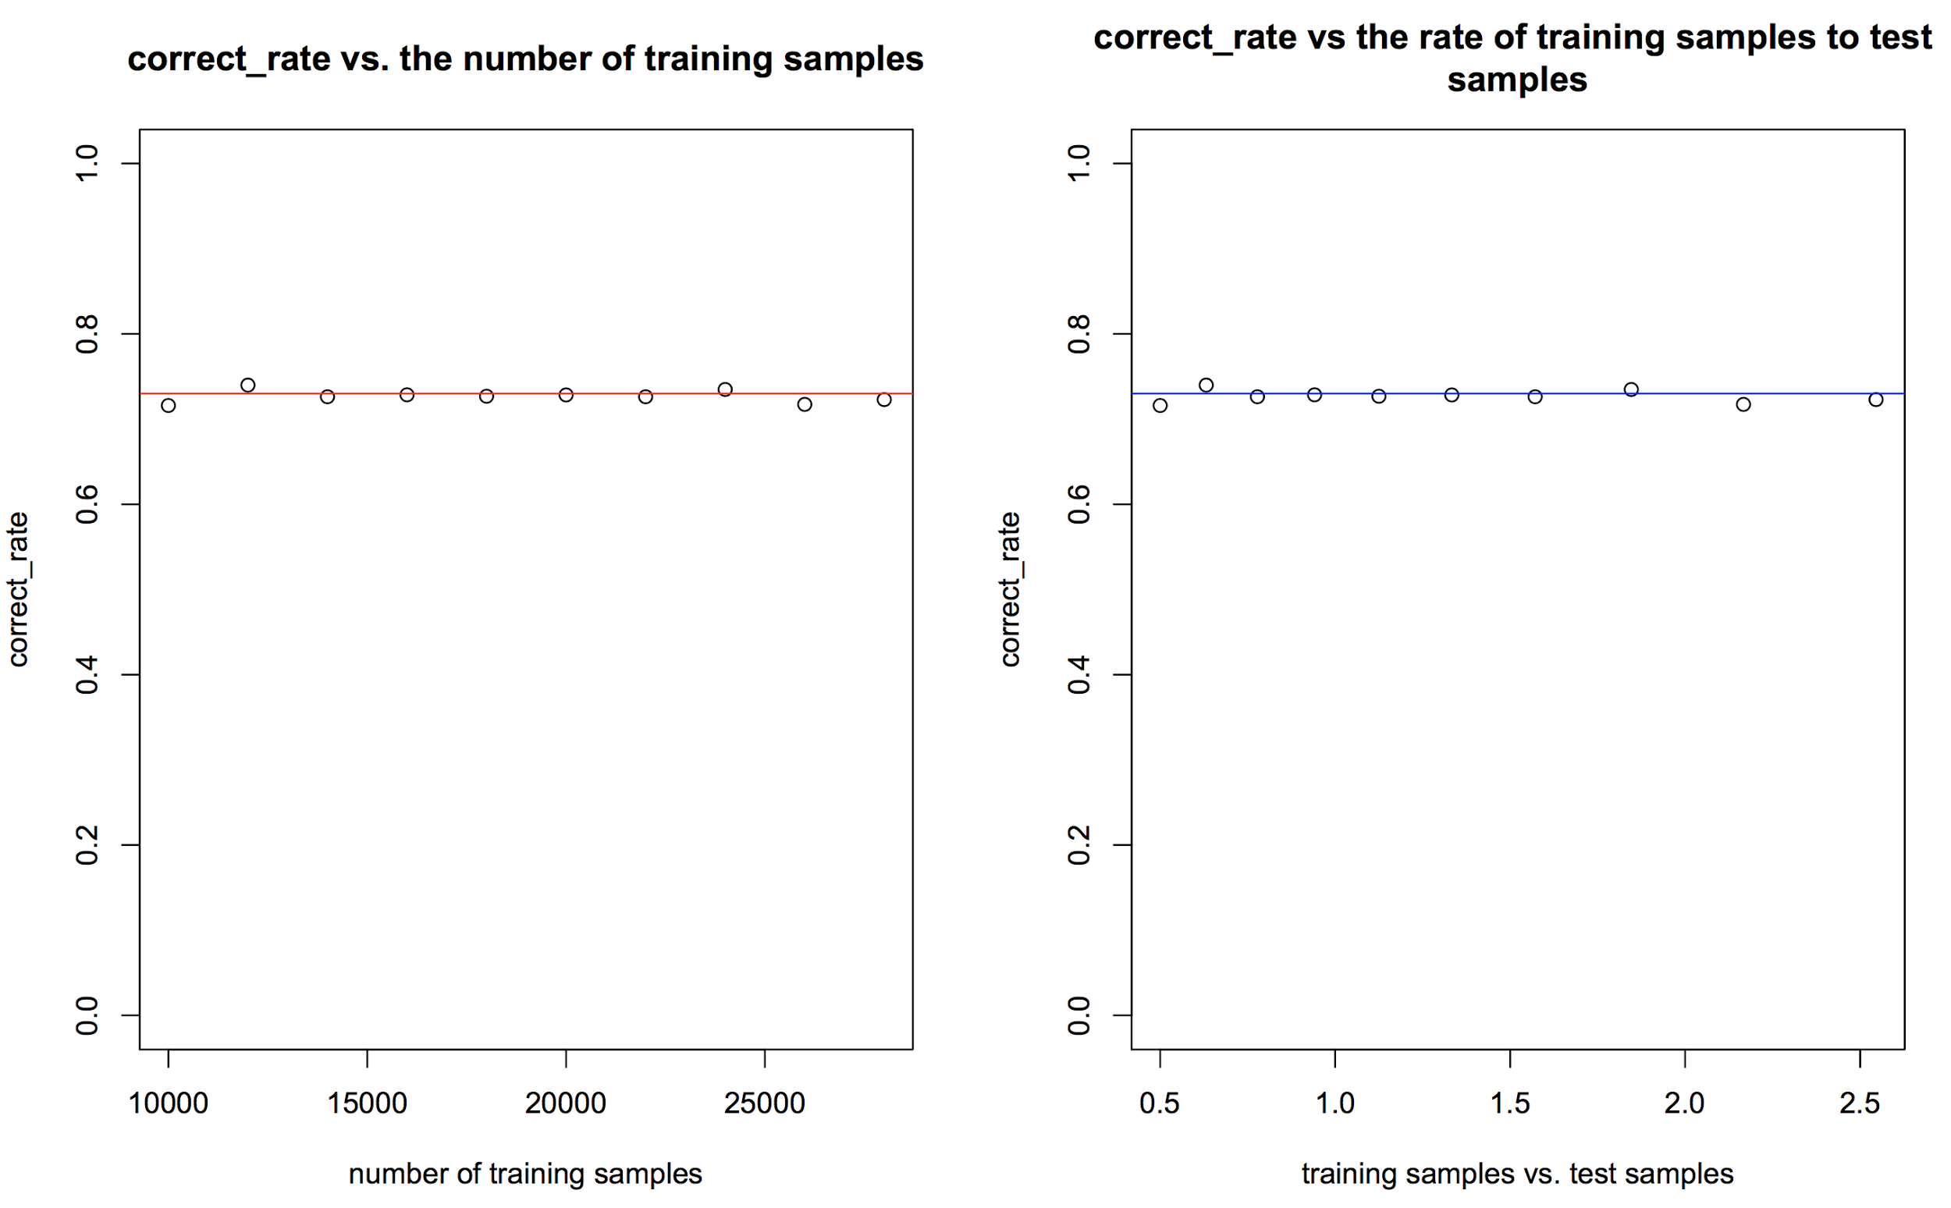
The results of the classification

Slide 16
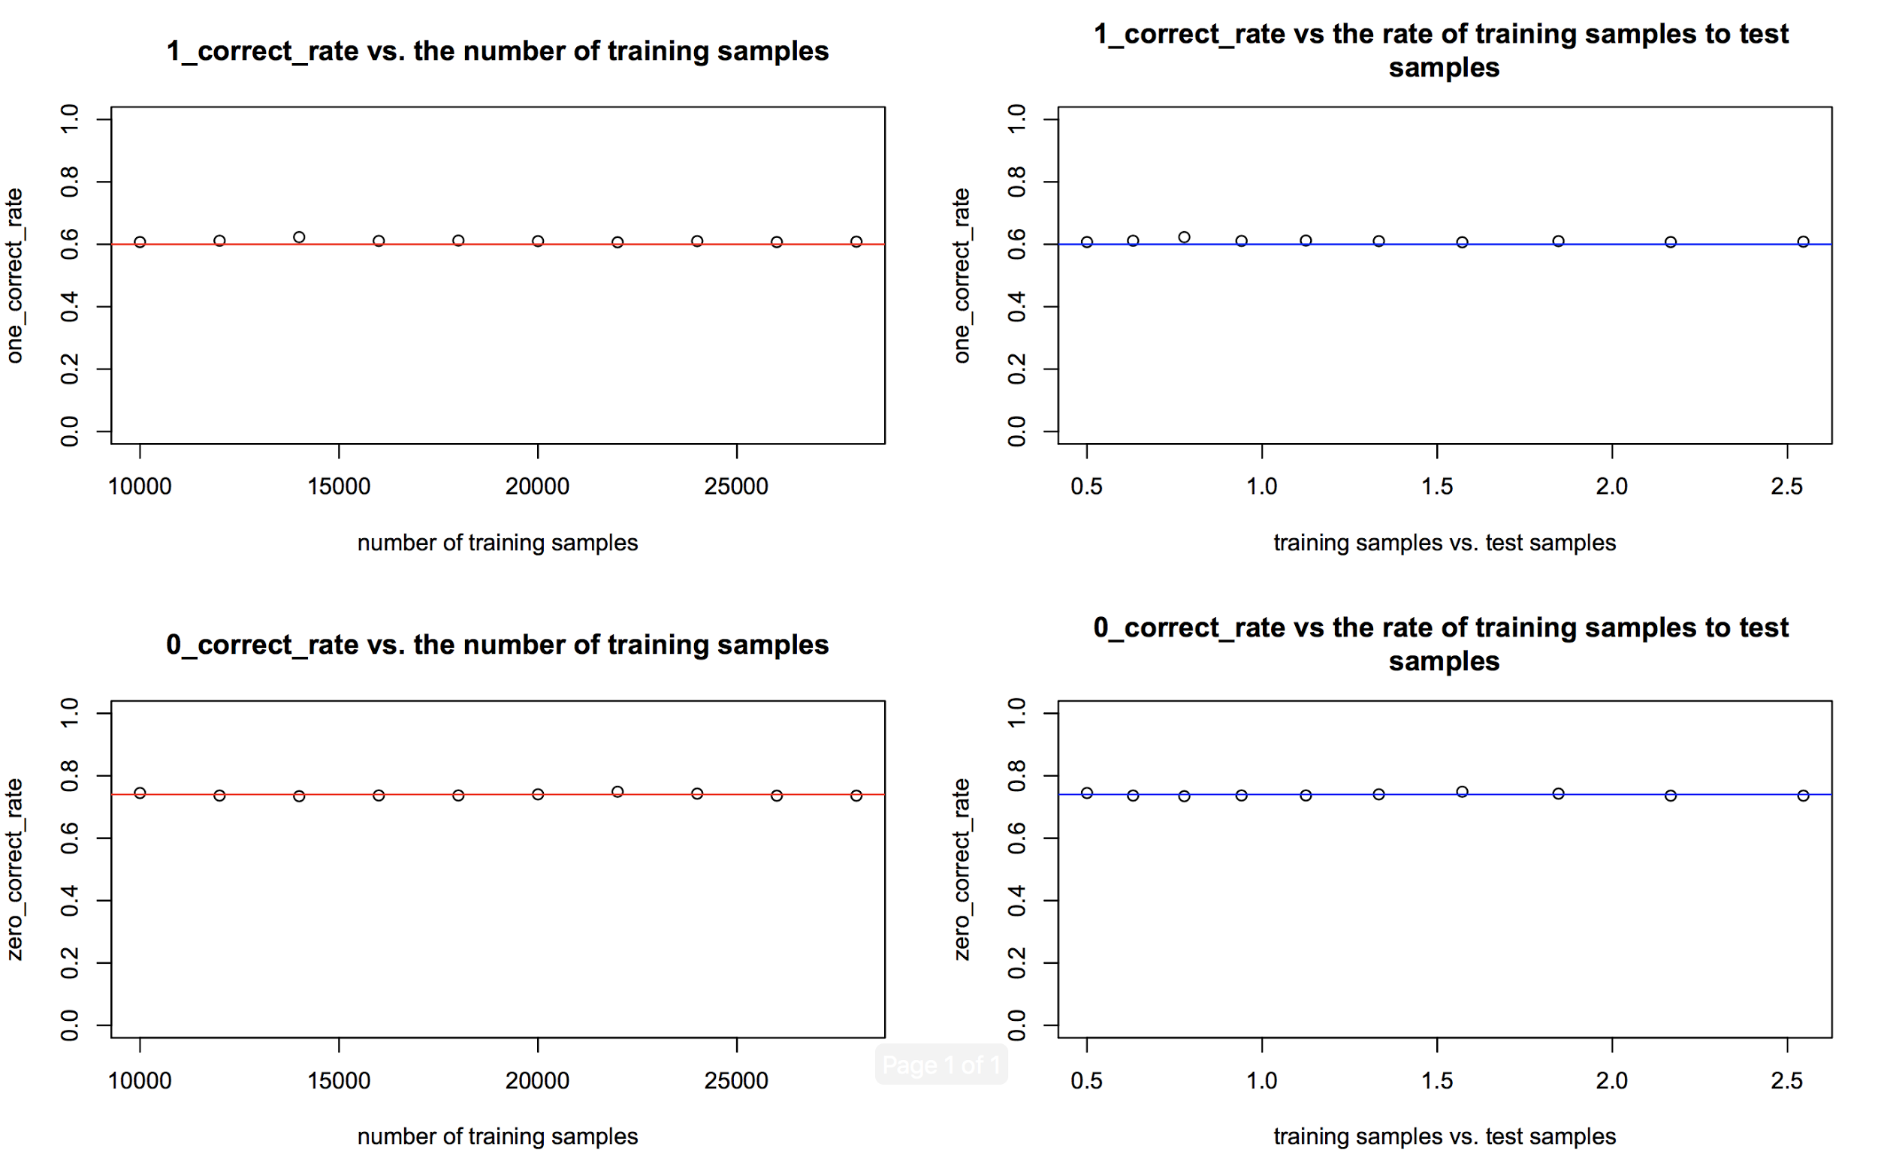

Slide 17
Hypothesis 3: Multiple Linear Regression
Data Preprocessing:
Remove some meaningless rows, such as “Education =5 or 6” or “Marital Status = 0 or 3.”
Create “X24” as a new variable that denotes the sum of history of payment, X6 to X11, which can show how people like to pay money back to bank, and make it to a positive number.
Also remove negative values in bill row, x12-x17, because negative statement makes no sense here.
Last but not least, we normalized columns for bills and payments.

Slide 18
Hypothesis 3: Outline For our Model
Hypothesis Test:
Good Model or Not? Are all the coefficients significant in our model?
Outline:
Examine correlation between each row to make sure there is no overfitting problem in our model. Then, we choose PCA method to create a variable which can represent the rows that have high correlation.
Fit a multi-linear model, use box-cox transformation and eliminate outliers and observations which surpass cook’s distance.
Show the result of our model and provide a way for us to increase our credit limit efficiently and effectively

Slide 19
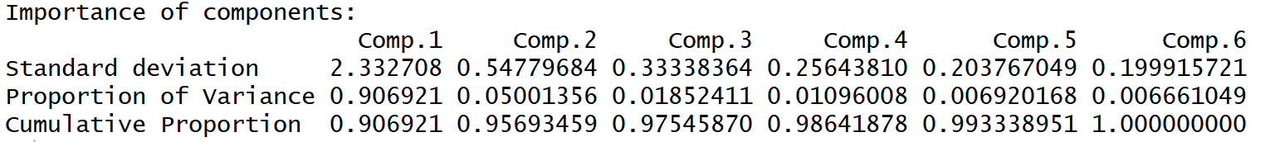
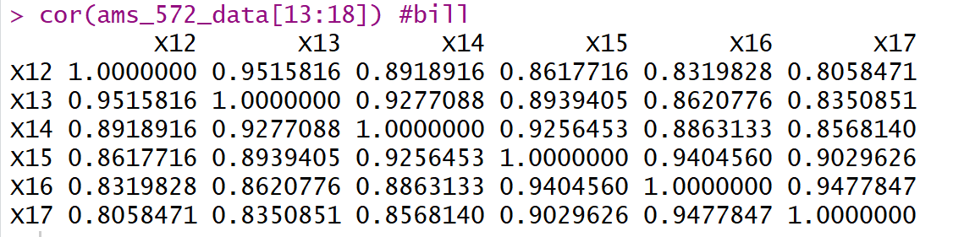
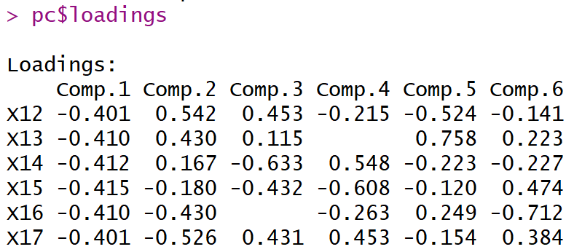
Correlation and PCA procedure
High Correlation between bill statement
Do PCA to these columns and get a Score using $score

Slide 20
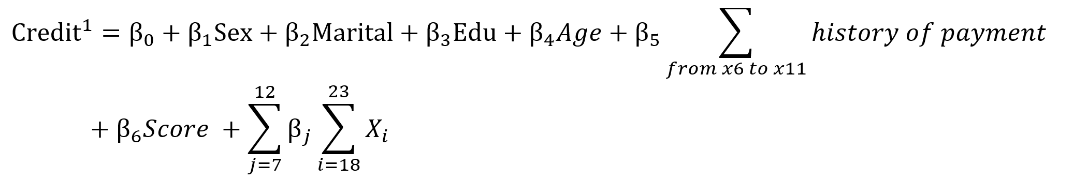
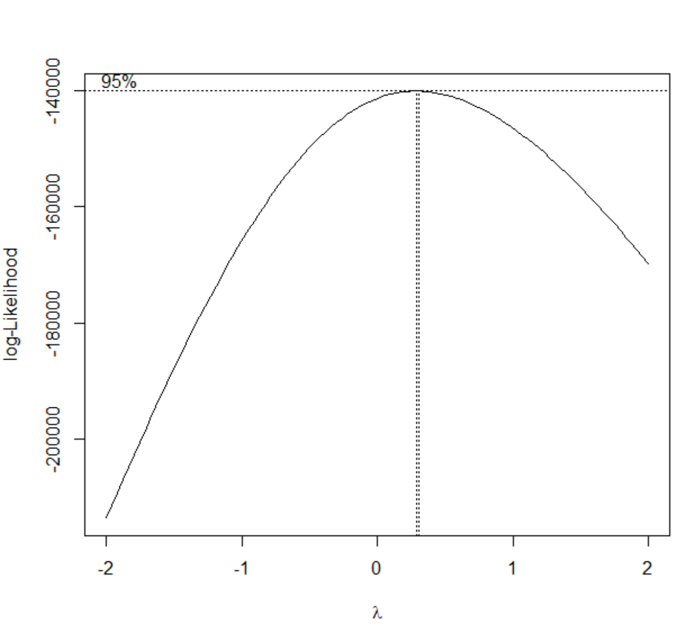
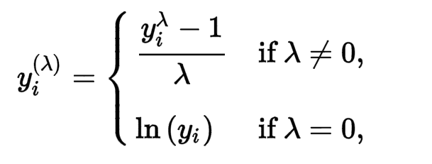
Fit a Multiple Linear Model
Since the result is not very satisfied, we do box-cox transformation to make it better.
Our result: Lambda =0.3

Slide 21
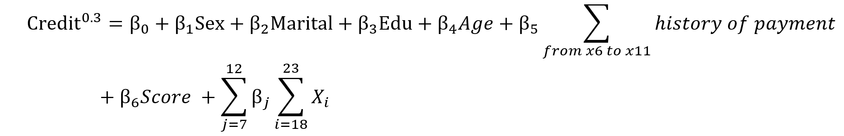
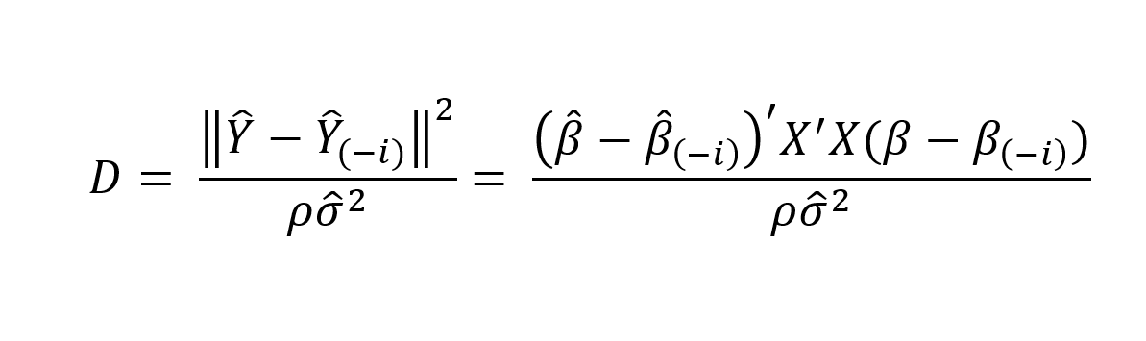
Fit a New Multiple Linear Model
However, the model would be better if we eliminate outliers to remove points with a strong influence on data - which is also known as cook’s distance. In R, we use OutlierTest function to test whether there are outliers, we will eliminate these outliers if p value of this test is less than 0.05, which means we can say this point is outlier. Also, after eliminating outliers, we will introduce the concept of cook’s distance to help us improve our model even better. Generally, if Di is larger than 0.5, we say that this point should be eliminated. Cook’s distance Di is:

Slide 22
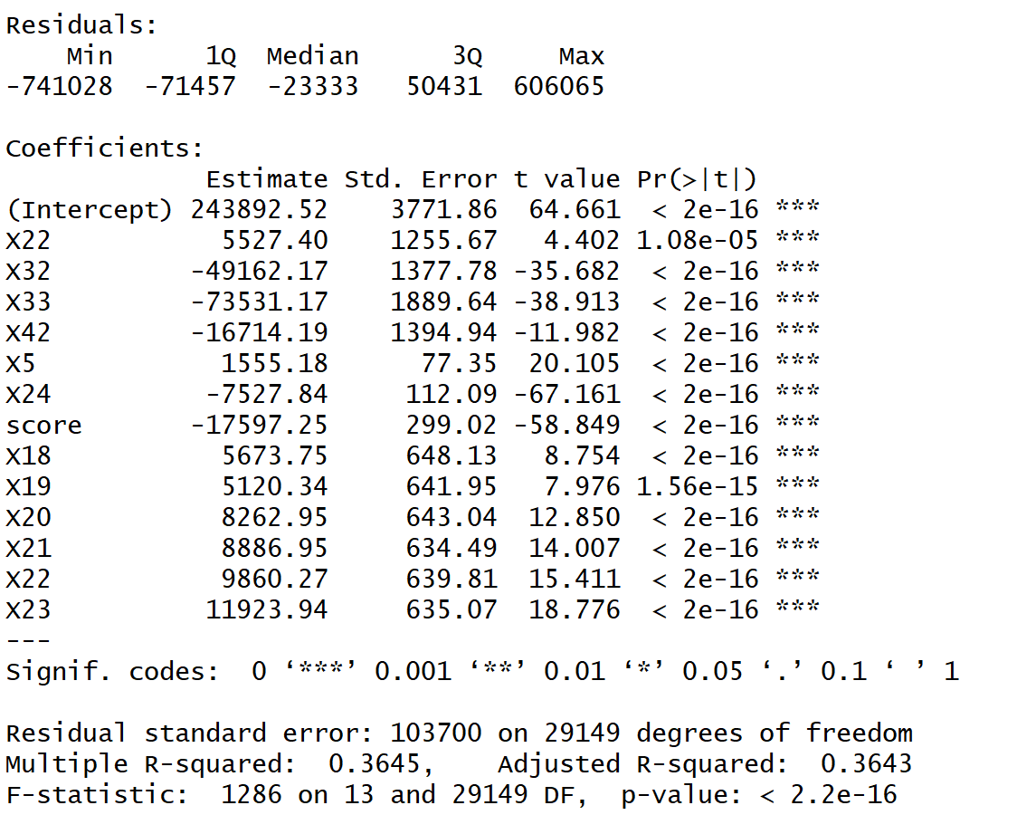
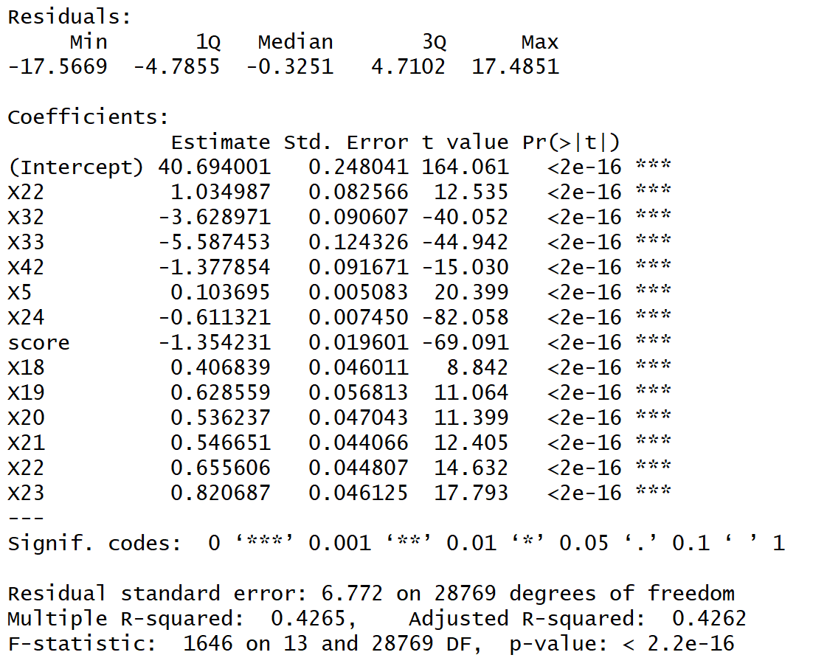
Results
After considering outliers and influential points by introducing cook’s distance, we have eliminated 380 rows or, in other word, observations. And our model has been actually improved after box-cox transformation, eliminating outliers and influential points:

Slide 23
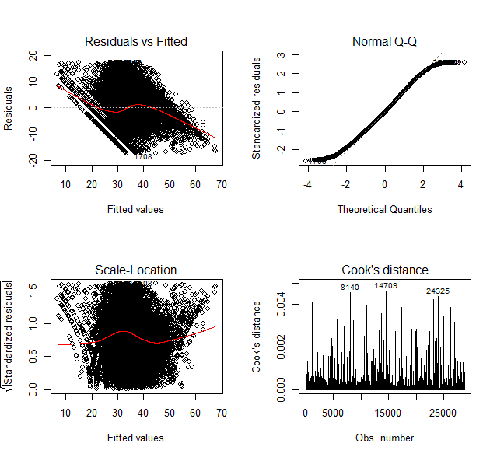
Results (cont’d)
--Residual Analysis
The reason why we get this graph is that credit limit is not exactly continuous in our dataset.
Our residuals fit a normal distribution very well.
Another graph to represent fitted values vs residuals.
After eliminating some points over our abline, it looks better.
1 | 2
3 | 4

Slide 24
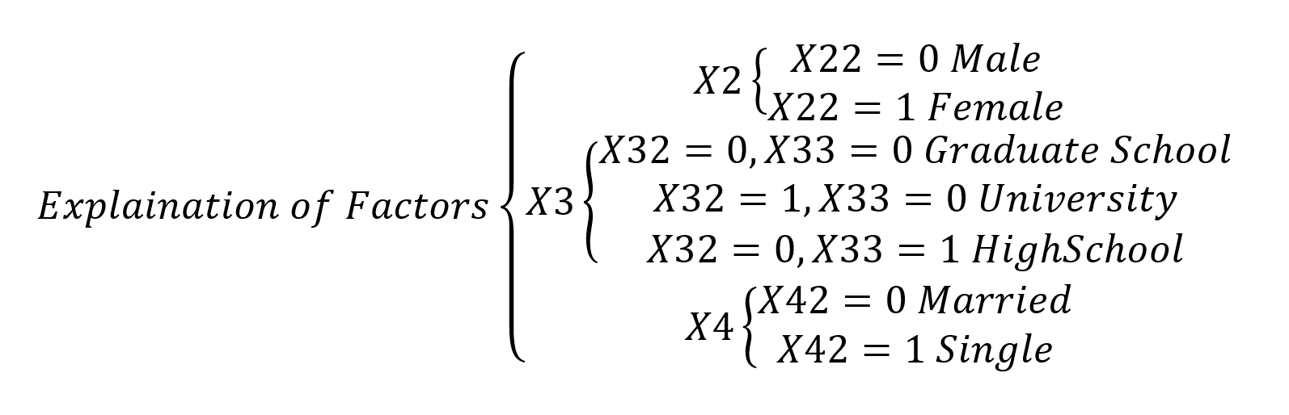

Hypothesis 3: Conclusion
First of all, all variables in our model are significant @0.001.
Then, there is no better model after doing stepwise in R, which means our model is best model given such variables.
According to this model, we Conclude that:

Slide 25
Questions?

Slide 26
Appendix: Hypothesis 1 Code
#reading dataset data = read.csv('dataset.csv', header = TRUE) data_bill_amt = data[,c(13:18)] #preprocessing subtracting april month data from rest other cols diff.names <- colnames(data_bill_amt)[1:5] diff <- vector('list',length(diff.names)) names(diff) <- diff.names diff <- matrix(nrow = dim(data)[1],ncol=5) dimnames(diff) <- list(rownames(diff),colnames(data_bill_amt)[1:5]) for (col_name in colnames(diff)){ diff[,col_name] <- (data_bill_amt[,col_name] -data_bill_amt$BILL_AMT6) } ## Plotting for boxplot, to check visually constant variance boxplot(c(log(diff)-min(diff))~rep(c(1:dim(diff)[2]),each=dim(diff)[1]))
##f - test to check for equal variance for (i in 1:4){ for (j in (i+1):5){ print(var.test(diff[,i],diff[,j])) } } #Equality on means of two bill amount with unequal var [t-test] for (i in 1:4){ print(t.test(diff[,i],diff[,i+1],var.equal = FALSE, conf.level = (1-0.1/4))) } ##plotting mean data mean_amt <- c(mean(diff[,5]),mean(diff[,4]),mean(diff[,3]),mean(diff[,2]),mean(diff[,1])) month_name <- c('May','June', 'July','August', 'September') plot(mean_amt, xlab = "Month", ylab = "Mean amount", xaxt='n', ann=FALSE) axis(1, at= 1:5, labels=month_name)

Slide 27
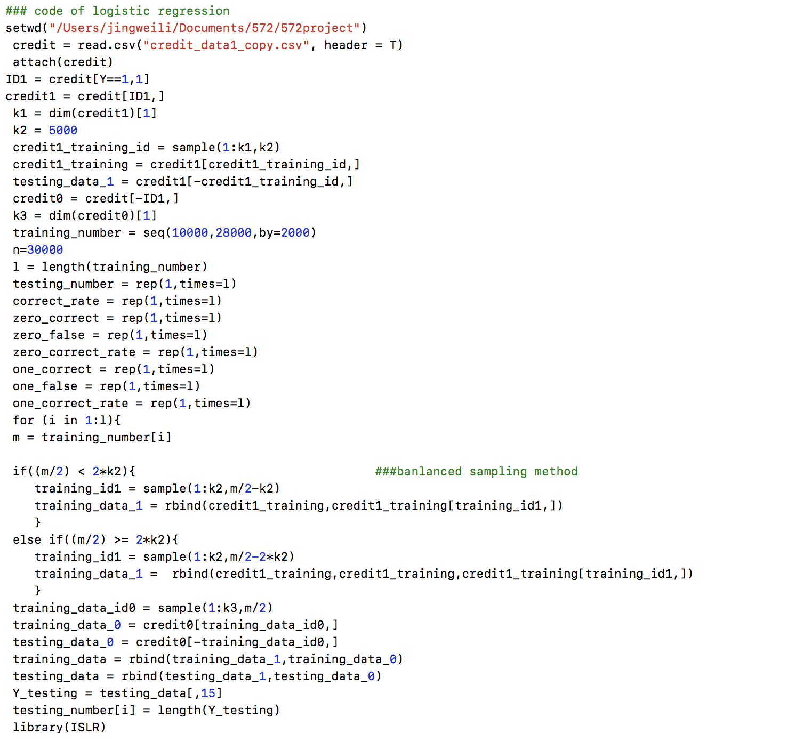
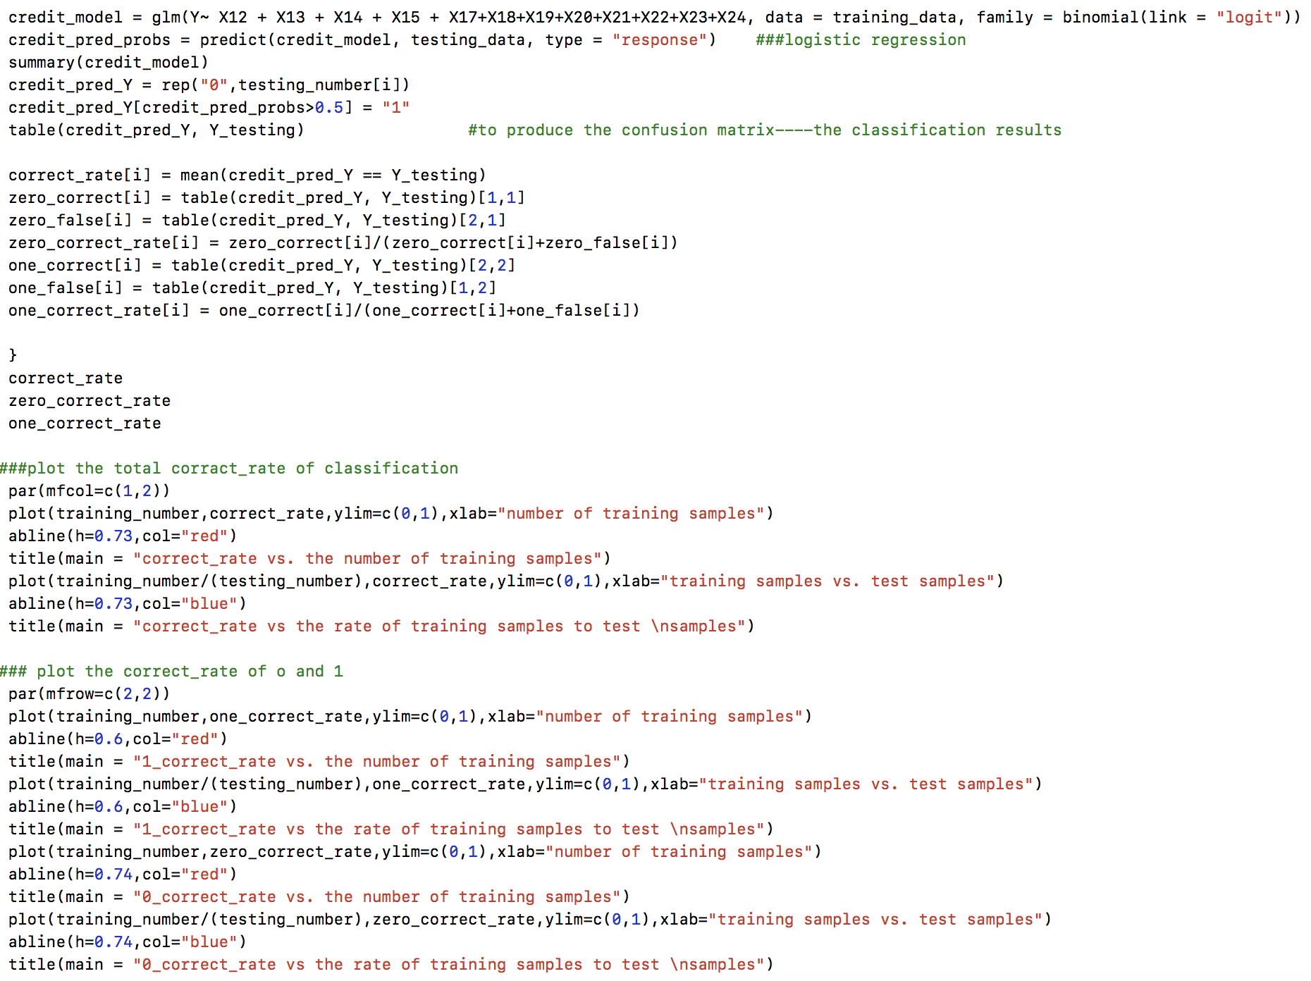
Appendix Hypothesis#2 R code

Slide 28
Appendix Hypothesis#3 R code
library(car)
library(MASS)
#reading dataset
data = read.csv('default.csv', header = TRUE)
#removing irrelavent data from education and maritial status
data <- subset(data, !(X3 %in% c(0,4,5,6)))
data <- subset(data, !(X4 %in% c(0,3)))
data = data[-1,]
#make it to numeric
for(i in 6:25){
data[,i] = as.numeric(as.character(data[,i]))
}
data$X1 = as.numeric(as.character(data$X1))
#check if they are numeric
sapply(data,class)
#sum of bill payments, converting the negatives to postive
data$sum_pay <- data$X6+data$X7+data$X8+data$X9+data$X10+data$X11
data$sum_pay <- data$sum_pay - min(data$sum_pay)+1
ams_572_data <- data
attach(ams_572_data)
#normalize
for (j in 13:24) {
ams_572_data[,j] = (ams_572_data[,j]-mean(ams_572_data[,j]))/sd(ams_572_data[,j])
}
colnames(ams_572_data)[colnames(ams_572_data)=="sum_pay"] = "X24" #calculate the sum of X6 to X11
detach(ams_572_data)
attach(ams_572_data)
cor(ams_572_data[13:18]) #bill
cor(ams_572_data[19:23]) #payment
cor(ams_572_data[7:12]) #due date
#PCA Analysis to get the vector that can denote all columns in our data
pc = princomp(ams_572_data[,13:18],cor = T,scores = T)
summary(pc)
pc$loadings
score = pc$scores[,1]
fit1 = lm(X1~X2+X3+X4+X5+X24+score+X18+X19+X20+X21+X22+X23)
summary(fit1)
#BOXCOX transformation
bc = boxcox(fit1)
bc$x[which.max(bc$y)]
fit2 = lm(X1^0.3~X2+X3+X4+X5+X24+score+X18+X19+X20+X21+X22+X23)
summary(fit2)
#where x2-x4 are factors
#we need consider the influence of OutLier
outlier = outlierTest(fit2)
while(outlier$p<0.01){
row = as.numeric(names(outlier$p))
ams_572_data = ams_572_data[c(-row),]
detach(ams_572_data)
attach(ams_572_data)
pc = princomp(ams_572_data[,13:18],cor = T,scores = T)
score = pc$scores[,1]
fit2 = lm(X1^0.3~X2+X3+X4+X5+X24+score+X18+X19+X20+X21+X22+X23)
outlier = outlierTest(fit2)
}
result<-cooks.distance(fit2)
cook=4/(fit2$df)
plot(fit2,which=4,cook.levels=cook)
abline(h=0.004,lty=2,col=2)
sum(result>0.004)
Data_new = ams_572_data[!result>0.004,]
detach(ams_572_data)
attach(Data_new)
pc = princomp(Data_new[,13:18],cor = T,scores = T)
score = pc$scores[,1]
fit3 <- lm( X1^0.3 ~ X2+X3+X4+X5+X24+score+X18+X19+X20+X21+X22+X23+X24,data = Data_new)
summary(fit3)
par(mfrow=c(2,2))
plot(fit3,which = 1:4)

